Slide 1
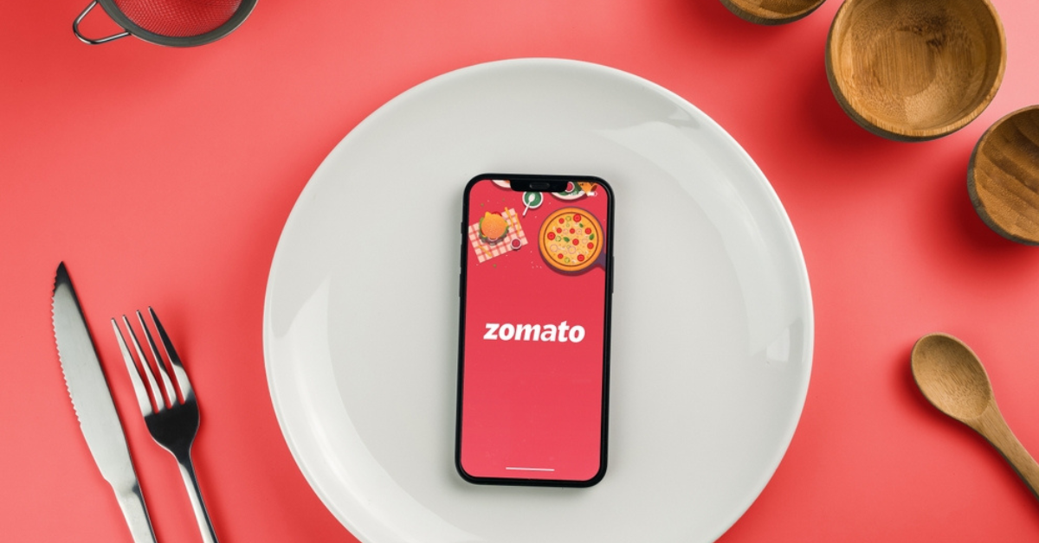
Exploratory Data Analysis on Zomato Dataset
Exploratory Data Analysis on Zomato Dataset
By : Rahul
By: Rahul

Slide 2

Introduction
Zomato is a popular restaurant aggregator and food delivery platform.
Dataset contains information on restaurants, cuisines, ratings, costs, and locations.
Exploratory Data Analysis (EDA) is performed to discover trends and patterns.
EDA helps in understanding customer preferences and business opportunities.
Introduction
• Zomato dataset provides restaurant details
• EDA helps identify trends, patterns, and insights
• Useful for business strategy and decision making

Slide 3
Objectives
• Understand restaurant trends
• Analyze ratings, costs, and cuisines
• Identify customer preferences
• Provide insights for decision making

Slide 4
Dataset Overview
Total Records (Rows): ~9,550 restaurants (varies by dataset version)
Total Features (Columns): ~17 attributes
🔑 Key Columns
Restaurant Name – Name of the restaurant
Country Code / City / Location – Geographical details
Cuisines – Type(s) of food served
Average Cost for Two – Cost indicator for customers
Price Range – Numeric cost category
Currency – Currency used in pricing
Has Table booking – Yes/No
Has Online delivery – Yes/No
Aggregate Rating – Average customer rating
Rating Color / Rating Text – Qualitative representation of ratings
Votes – Number of customer votes/reviews

Slide 5
Data Cleaning
Checked for Missing Values
df.isnull().sum()
→ Identified null values in the dataset.
Handled Null Values (Imputation)
Filled missing values in Delivery_person_Age with mean.
Filled missing values in Delivery_person_Ratings with median.
Filled missing values in Weather_conditions, Road_traffic_density, multiple_deliveries, Festival, and City with mode.
Dropped Rows with Missing Values
Removed rows where Time_Orderd was missing.
Converted Data Types
Changed Delivery_person_Age to integer (int64).

Slide 6
Exploratory Data Analysis
• Distribution of ratings
• Most popular cuisines
• Cost for two analysis
• Location-wise availability

Slide 7
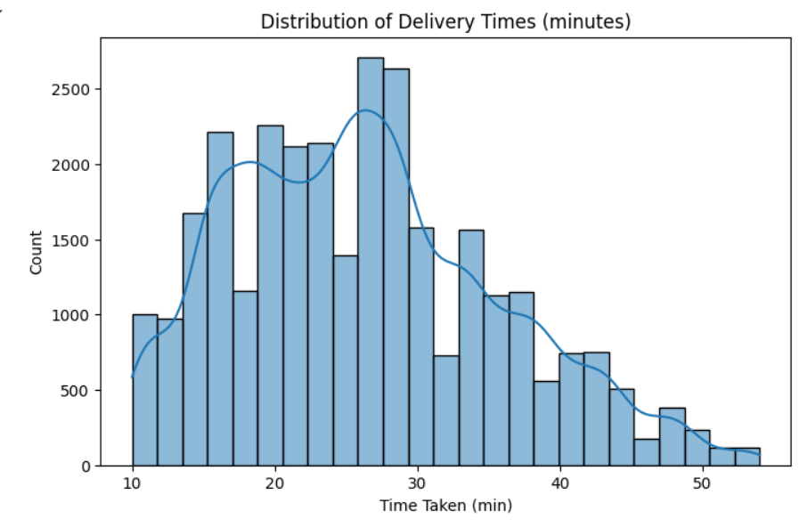
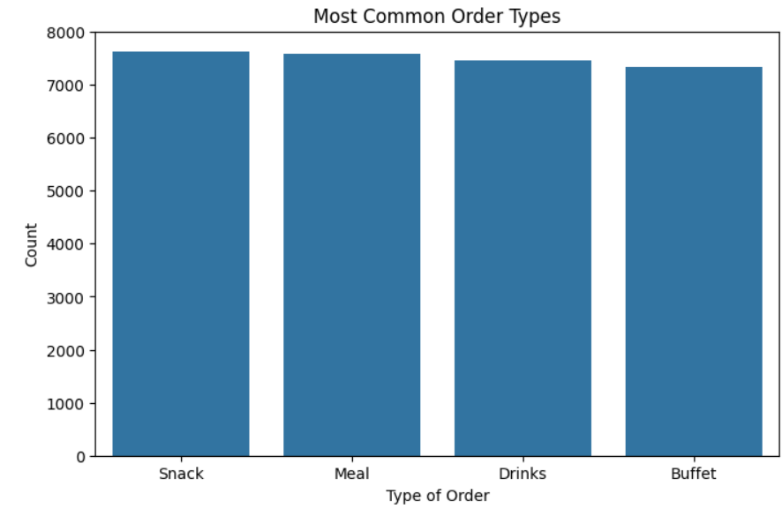
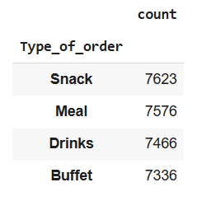
Visualizations
Distribution of Delivery Times
Most common order

Slide 8
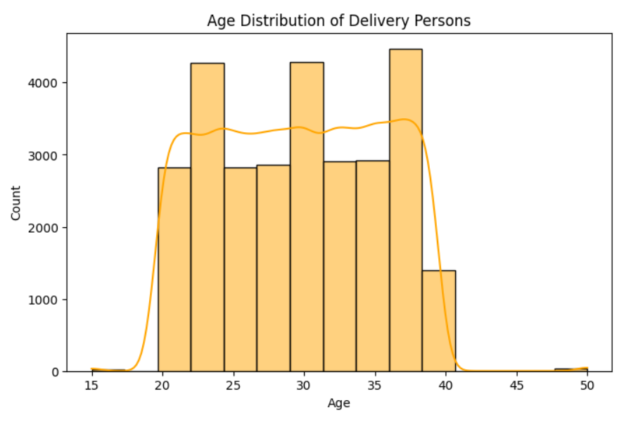
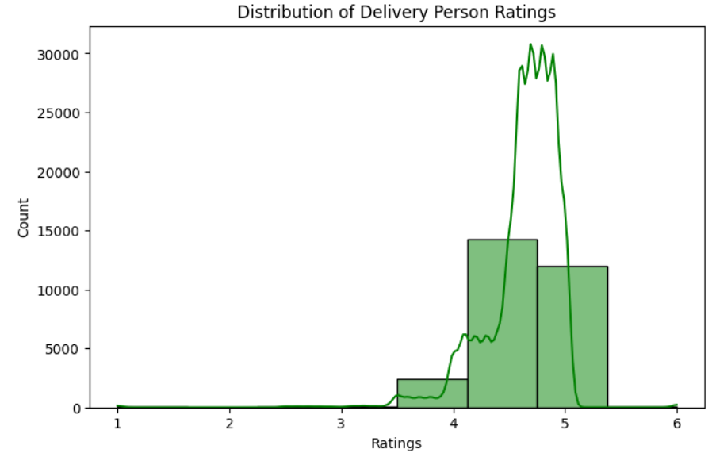
Age distribution of persons
rating distribution

Slide 9
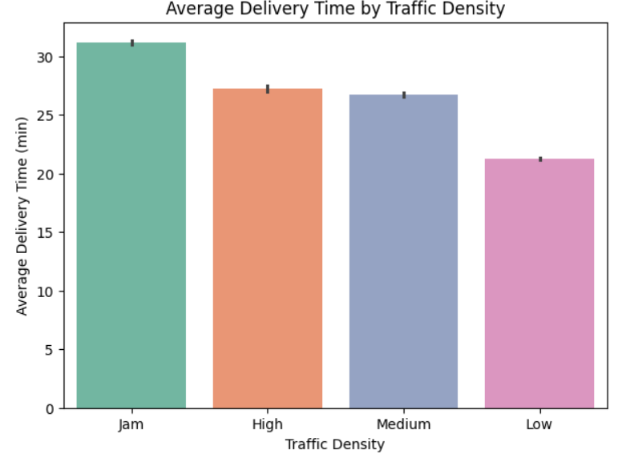
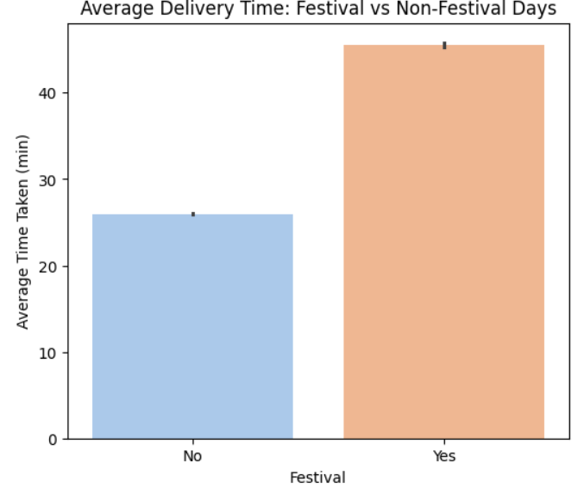
Delivery time vs traffic Density
Delivery time Vs festival days

Slide 10
Key insights
Distribution of Delivery Times: Most deliveries take 20–30 minutes, showing this is the typical delivery window. Very few deliveries take less than 10 minutes or more than 50 minutes.
👉 Insight: The service is fairly consistent, but efficiency improvements can target orders taking more than 40 minutes.
2. Most Common Order Types :Snacks are the most common orders (7,623), followed by Meals (7,576).Drinks (7,466) and Buffets (7,336) are slightly less frequent but still popular.
👉 Insight: Customers prefer lighter and quicker options (snacks) slightly more than meals, so promotions around snacks and combos could increase engagement.
3. Age Distribution of Delivery Persons: Most delivery persons fall between 20–35 years old, with peaks around 25 and 30.Very few are above 40.
👉 Insight: The workforce is young and active, aligning with the physically demanding nature of delivery jobs
4. Rating Distribution : Most ratings are 4 and 5, showing high

Slide 11
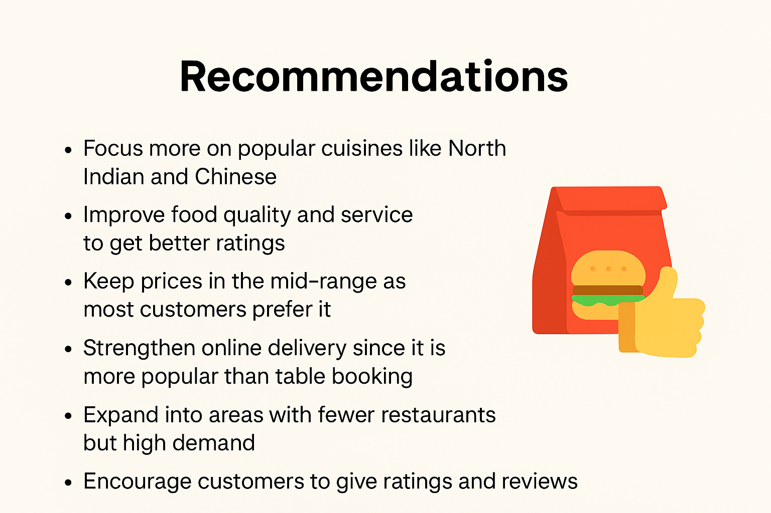
Recommendations
Focus more on popular cuisines like North Indian and Chinese.
Improve food quality and service to get better ratings.
Keep prices in the mid-range as most customers prefer it.
Strengthen online delivery since it is more popular than table booking.
Expand into areas with fewer restaurants but high demand.
Encourage customers to give ratings and reviews.

Slide 12

Conclusion
The Zomato dataset provides valuable insights into customer preferences and restaurant trends.
EDA revealed patterns in ratings, cuisines, cost distribution, and location-wise availability.
These insights help businesses improve service, set competitive pricing, and identify opportunities for growth.

Slide 13


Slide 14

Conclusion

